Slide 1
John fitzgerald & jackie kennedy
Marija Coric,8.d

Slide 2
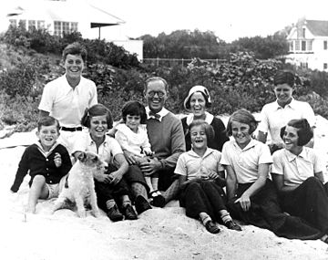
JOHN F. KENNEDY
born on May 29, 1917 in Brookline, Massachusetts
father businessman/politician , mother socialite
grandfathers were politicians, grandparetns were Irish immigrants
elder brother, Joseph Jr., and seven younger siblings; Rosemary, Kathleen, Eunice, Patricia, Robert, Jean, and Ted.
changed many schools
moved to a stately twenty-room, Georgian-style mansion

Slide 3
in Choate, a boarding school in Wallingford, Connecticut, he attracted a coterie, their most notorious stunt: blowing up a toilet seat
diagnosed with colitis
voted the „most likely to succeed”
was trained in the U.S. Navy Reserve
Princeton, Harvard

Slide 4
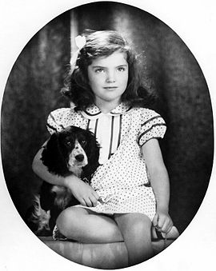
Jacqueline Lee Bouvier
born on July 28, 1929 in Southampton, New York
father Wall Street stockbroker, mother socialite
raised in Catholich faith
younger sister Lee

Slide 5
How they met
were formally introduced by a mutual friend an a diner party
love at first sight
were both Catholic, writers, enjoyed reading and both had previously lived abroad
eventually he proposed, eventually she accepted
engagemant was oficially announced on June 25, 1953

Slide 6
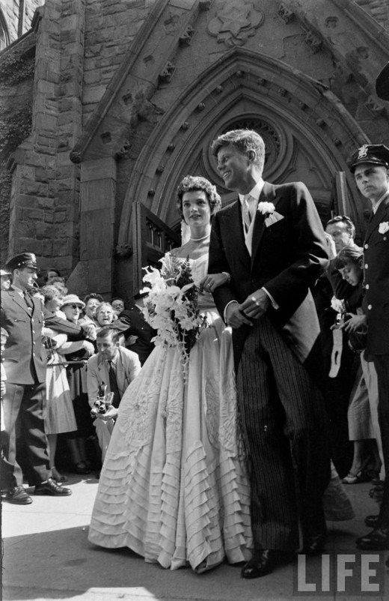
Marriage
married on September 12, 1953, at Saint Mary‘s Church in Newport, Rhode Island
Jonh suffered from Addison‘s Disease, Jackie a miscarriage (stillborn daughter Arabella)
First Daughter Caroline 1957
John announced his candidacy for the presidency, shortly after, Jackie became pregnant

Slide 7
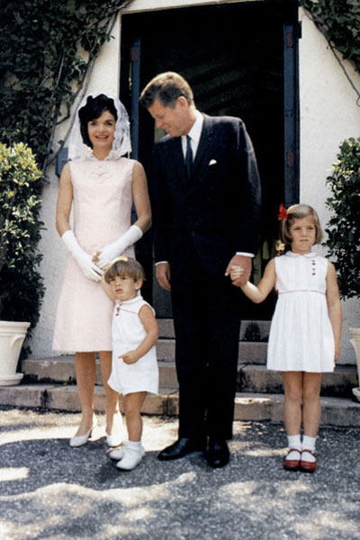
presidency
on November 8, 1960 John F. Kennedy beat his opponent Richard Nixon in the U.S. presidential election
First Son John F. Kennedy Jr., 17 days after
second First Son died two days after birth
Jackie entered a state of depression, although losing their child had a positive impact to the marriage as it brought the two closer together in their grief
A.S. stated that the marriage never seemed more solid than in the later months of 1963
Jackie weant on a yacht trip with John F. Kennedy‘s friend Aristotle Onassis

Slide 8
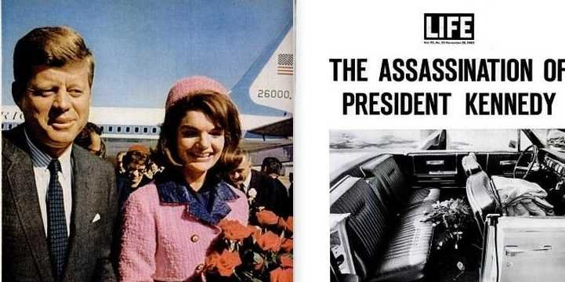
the assassination
JFK was killed while he was riding by his presidential motorcade through Dealey Plaza in Dallas, Texas
Jackie refused to remove her blood-stained pink dress and said that she regretts washing the blood of of her face and hands
assassin was Lee Harvey Oswald
Jackie found a great source of upport in Robert F. Kennedy
when he also was killed she married her friend Aristotle Onassis and was given the nickname Jackie O

Slide 9
thank you for your attention

